Slide 1
Predicting GOOGL Stock Price
By: David Lee, Karan Bhatia

Slide 2
Agenda
Motivation
Data Gathering
Data Exploration
Prediction Models
Understanding price changes over time

Slide 3
Motivation

Slide 4
Motivation
We're all soon going to enter the full-time workforce and start making "real money"
How should that money be managed to ensure longevity and financial stability?
Popular money management technique: investing in the stock market
The idea is simple - buy low, sell high, make money

Slide 5
Research Question
How can you predict prices of stocks to optimize when you buy and when you sell?

Slide 6
Data Gathering

Slide 7
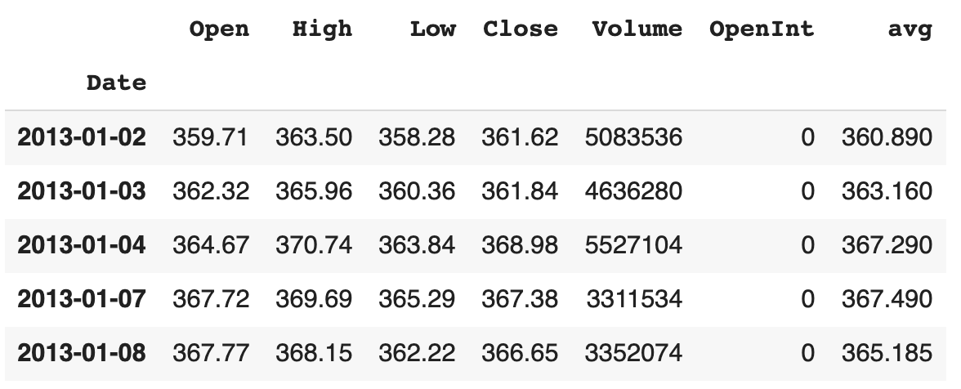
Data Gathering
GOOGL stock data - Alphabet Class A Shares: https://www.kaggle.com/borismarjanovic/price-volume-data-for-all-us-stocks-etfs#aadr.us.txt

Slide 8
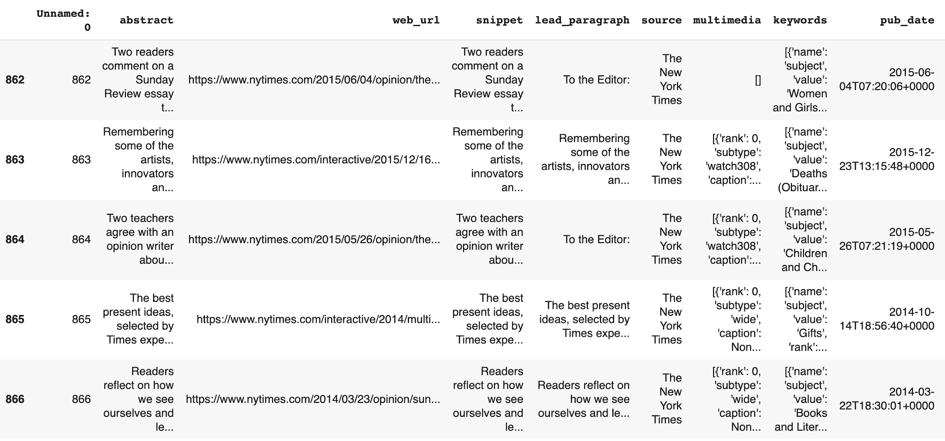
Data Gathering
News data related to Alphabet/Google from 2013-2016, scraped from the New York Times API

Slide 9
Data Exploration

Slide 10
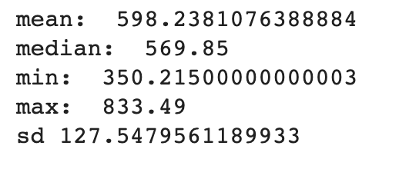
Data Exploration
Basic summary statistics

Slide 11
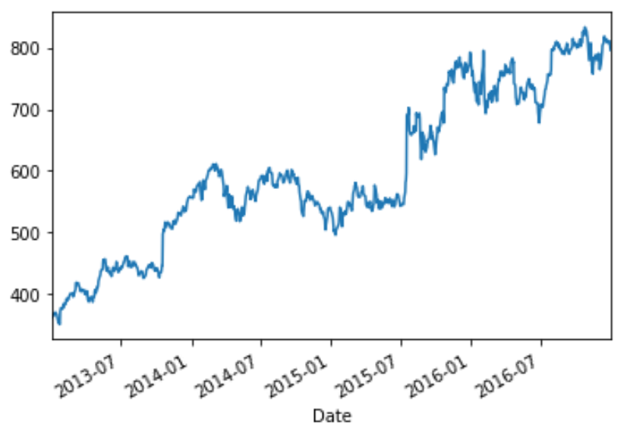
Data Exploration
Time series plot of all GOOGL prices from 2013-2016

Slide 12
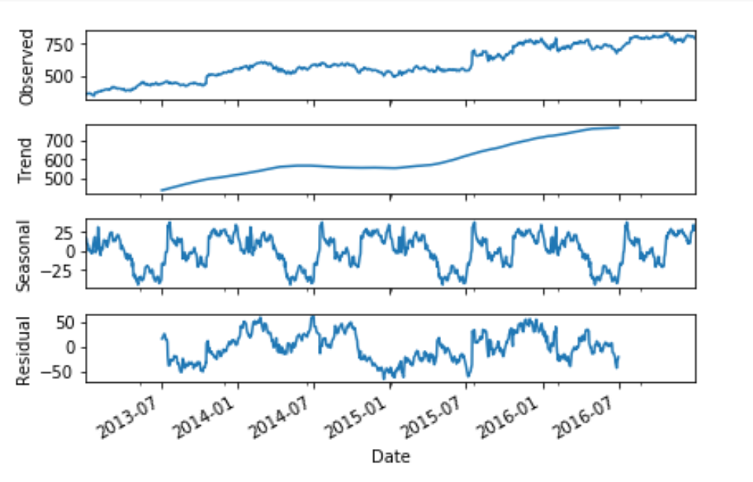
Data Exploration
Decomposed plot of the time series

Slide 13
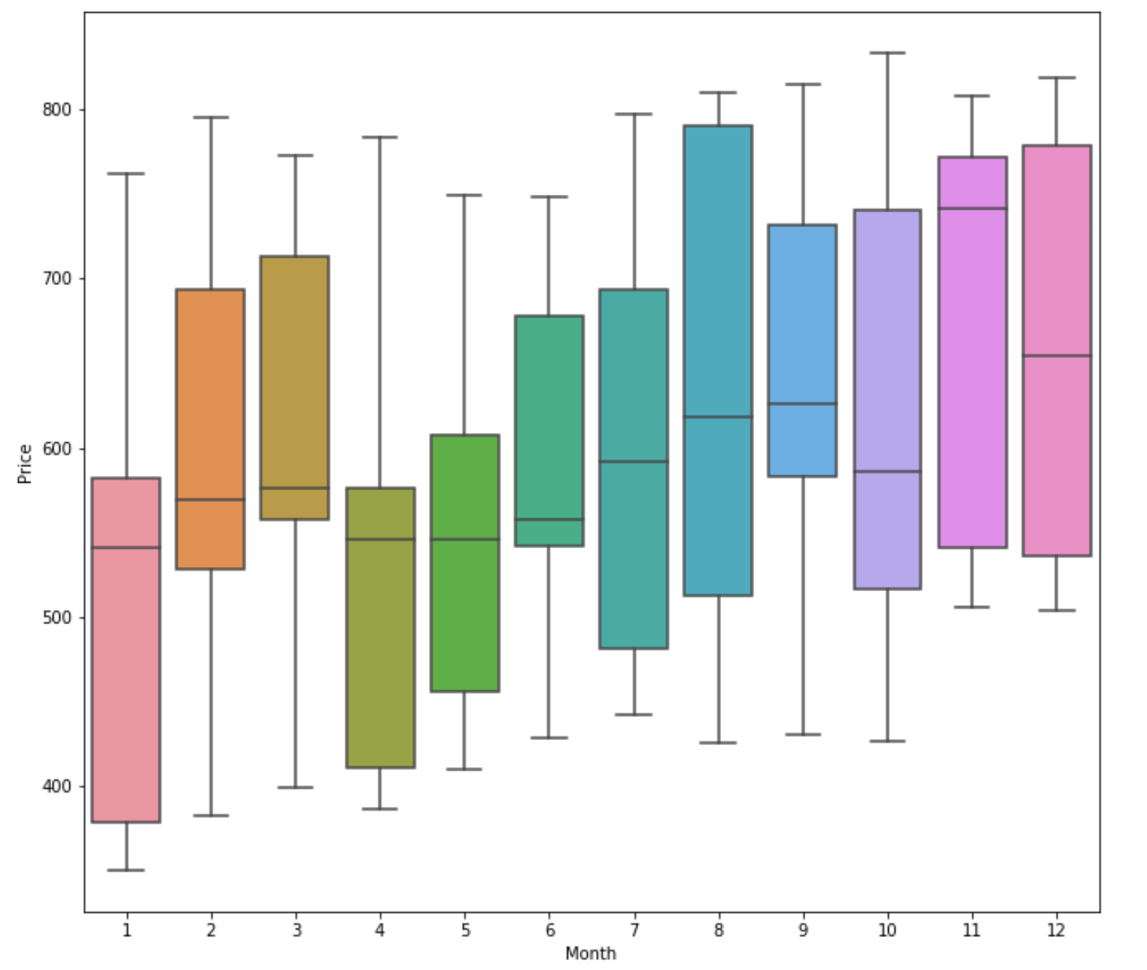
Data Exploration
Plot of seasonality by month

Slide 14
Prediction Methods

Slide 15
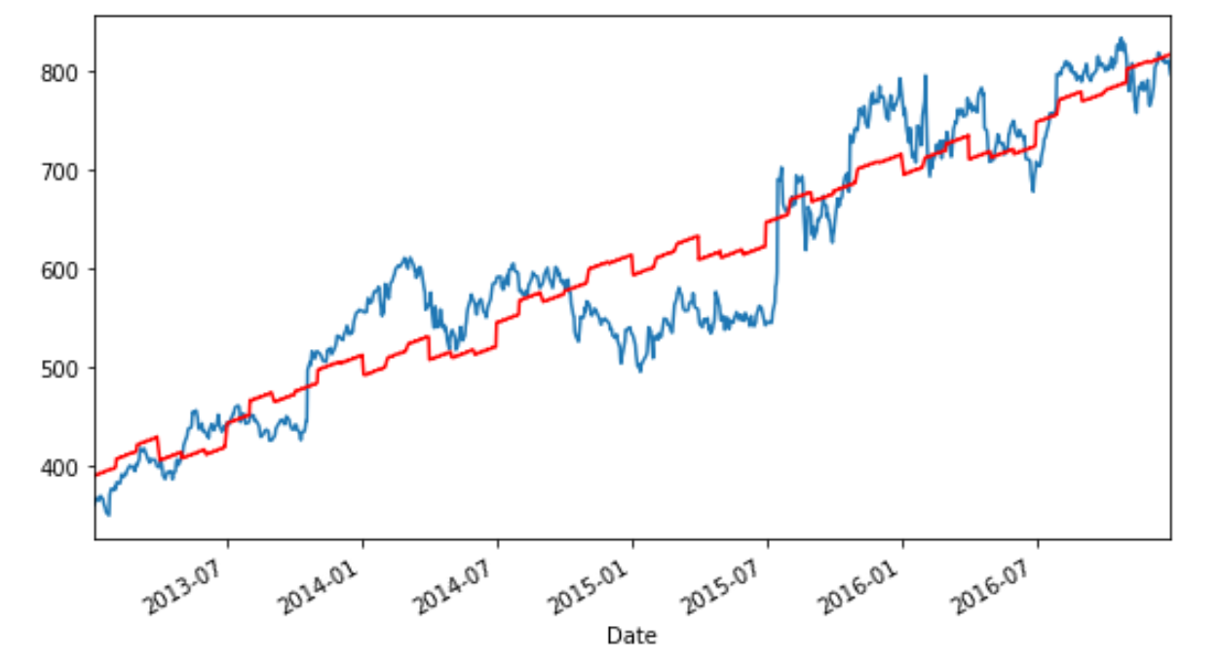
Prediction Methods
Generalized least squares regression with transformed time and categorical seasonality
Accounts for the fact that errors are correlated over time

Slide 16
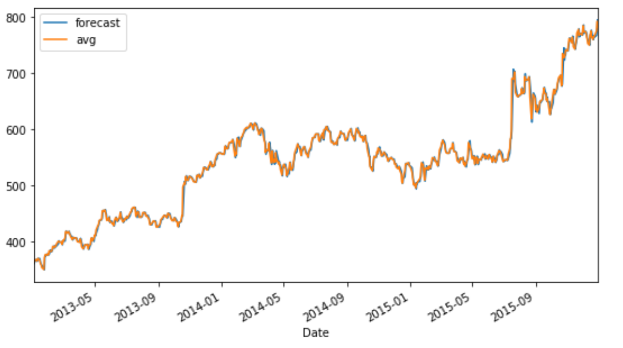
Prediction Methods
ARIMA model
Predicts future values based on previous values and previous errors

Slide 17
Prediction Methods
Long Short Term Memory Model
Type of Recurrent Neural Network (RNN) that optimizes storage of previous data points that can be used to effectively predict future data points
Example: predicting the blank I am a Golden State Warriors fan… I am from the Bay Area… I like Mexican food… My favorite basketball player is _____

Slide 18
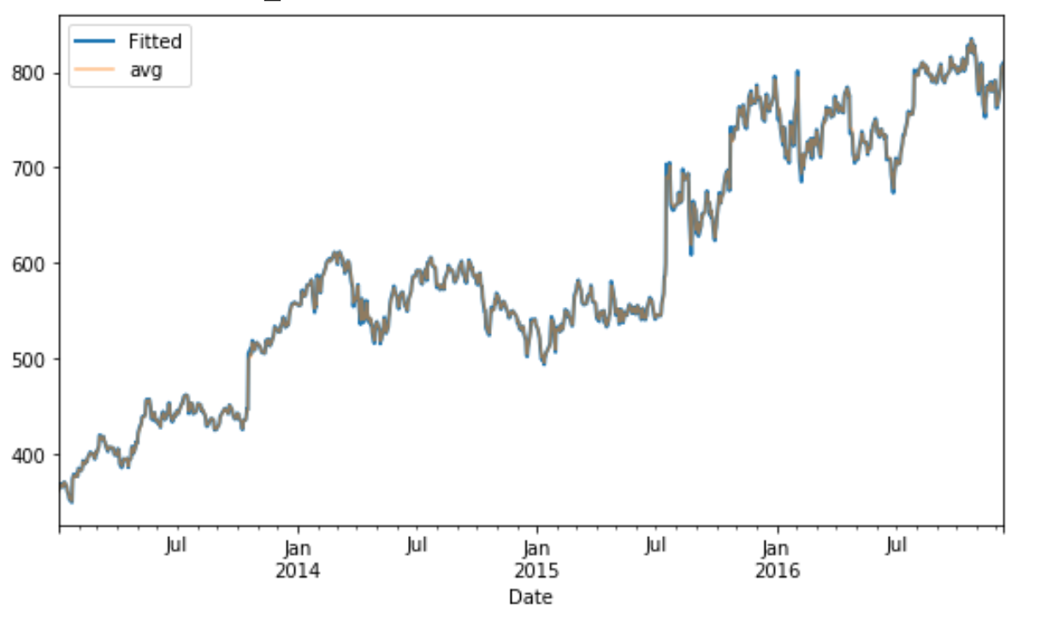
Prediction Methods
Long Short Term Memory Model

Slide 19
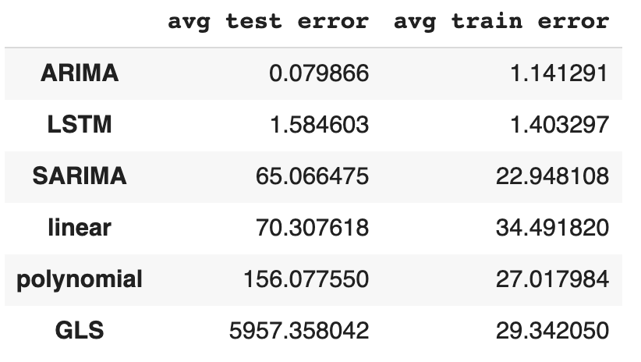
Prediction Methods
So what was the best model for prediction?
Manually conducted 5-fold cross-validation to compute test and train errors for each model we tests

Slide 20
Understanding Price Changes Over Time

Slide 21
Understanding Changes
So now we know the numbers behind the trend and seasonality of the data over time…
But why are these changes happening?
Prices react to new information in real time
I.e. a good or bad earnings announcement, announcement of layoffs, etc.
How do we know how prices will react?

Slide 22
Sentiment Analysis
Analyzed New York Times news headlines that involved Alphabet/Google
Assigned negative/positive sentiment scores based on if the headline was "positive" or "negative"
Used pre-built Lexicon from afinn that assigns scores per word
Headlines given an aggregate score based on the words

Slide 23
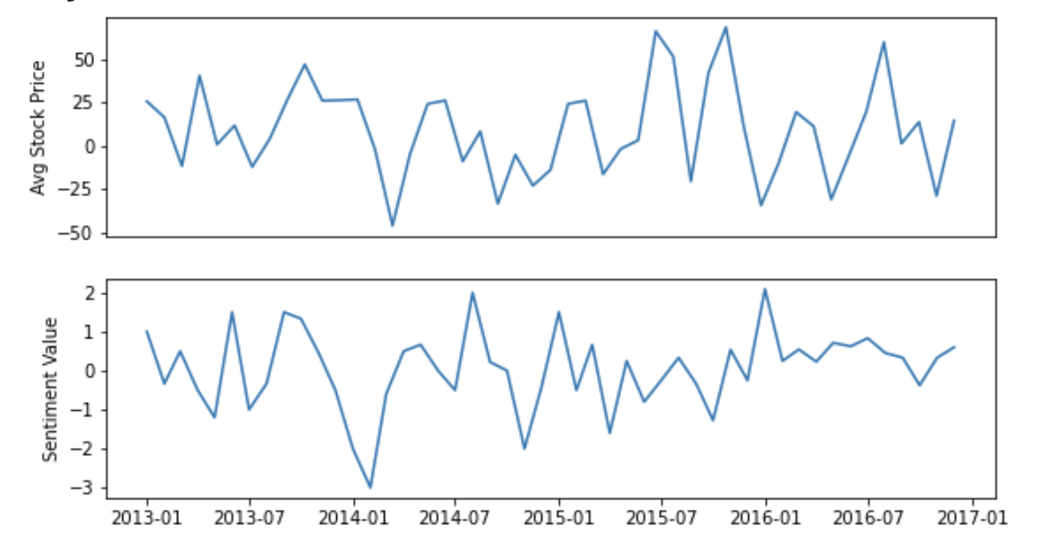

Slide 24
Thanks!
Any questions?

